Slide 1
FlowShop – The Flower Delivery App
SHRI SHAMBHUBHAI V. PATEL COLLEGE OF COMPUTER SCIENCE & BUSINESS MANAGEMENT VEER NARMAD SOUTH GUJARAT UNIVERSITY (VNSGU)
B.C.A 5th Semester 2022-2023
Submitted by,
Bhargav Vagadiya

Slide 2
Index
Project Profile
Objective
System Flowchart
ER Diagram
Data Flow Diagram
Screenshots
Limitations
References

Slide 3
Project Profile
PROJECT TITLE | FlowShop – The Flower Delivery App
PROJECT TYPE | Mobile Application
FRONTEND | Flutter
BACKEND | SQLite
OPERATING SYSTEM | Android
INTERNAL GUIDE | Asst.Prof Sweety Patel
DEVELOPED BY | Bhargav Vagadiya

Slide 4
Objective
The main objective of This app to user can view , purchase and manage the Product.

Slide 5
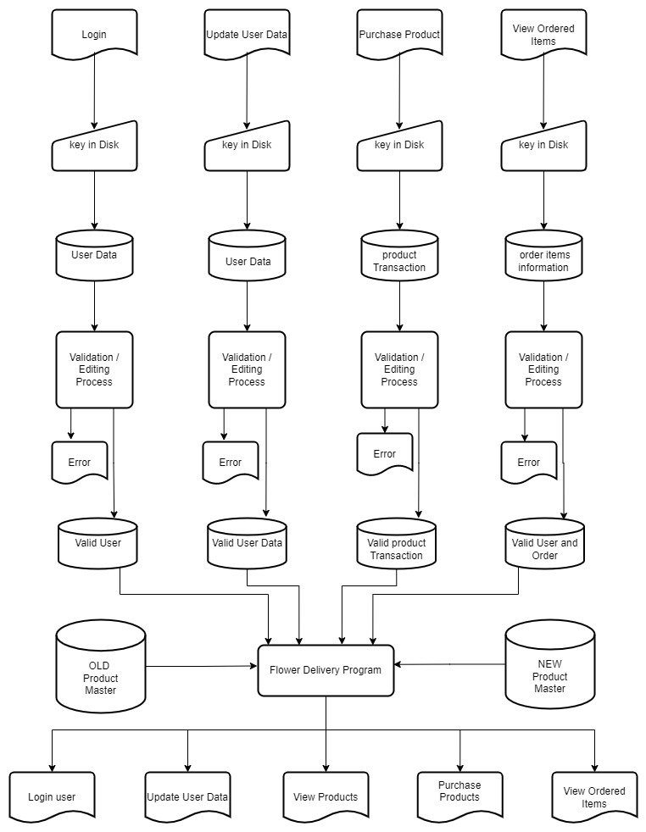
System Flowchart

Slide 6
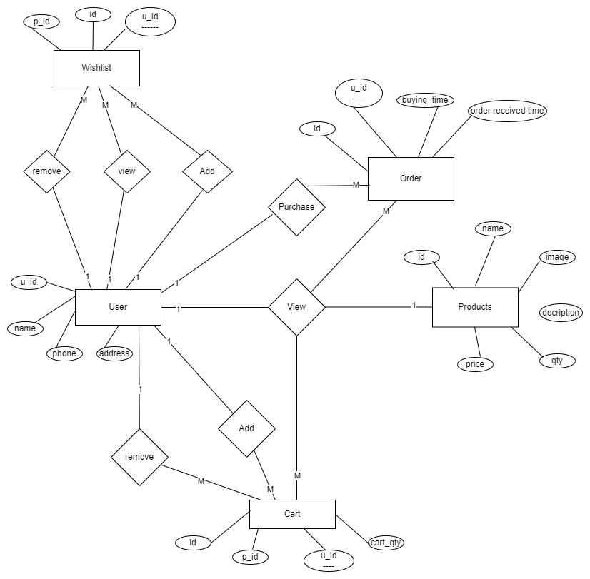
ER Diagram

Slide 7
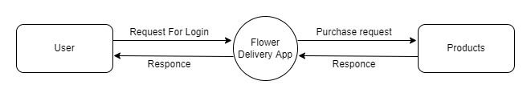
Data Flow Diagram
Context level DFD

Slide 8
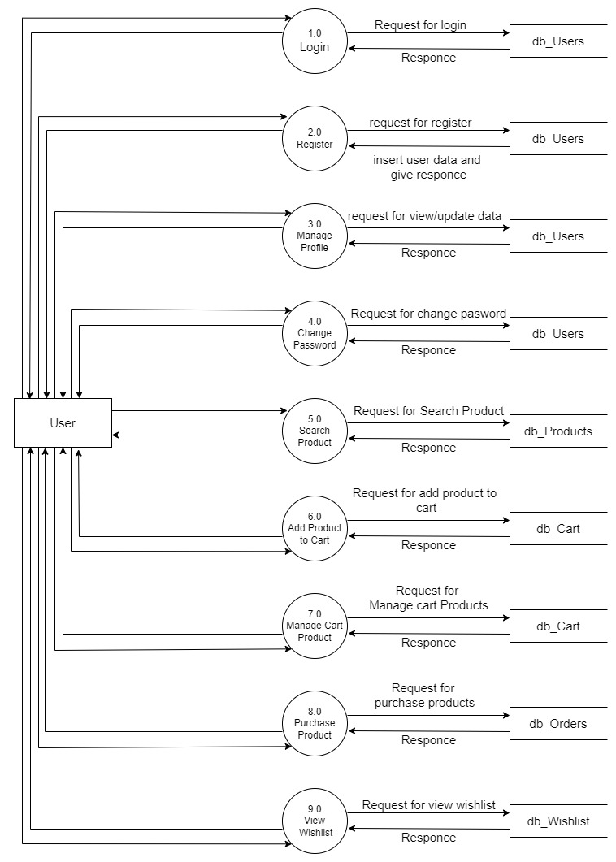
1st Level DFD

Slide 9
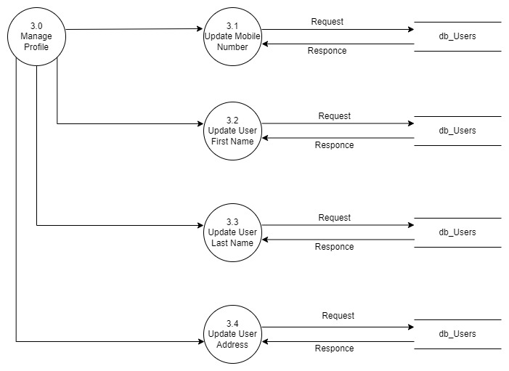
2nd Level DFD

Slide 10
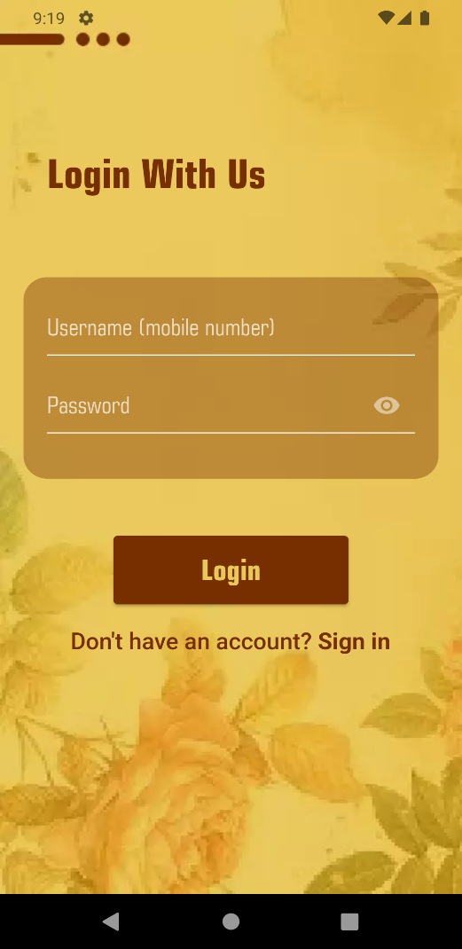
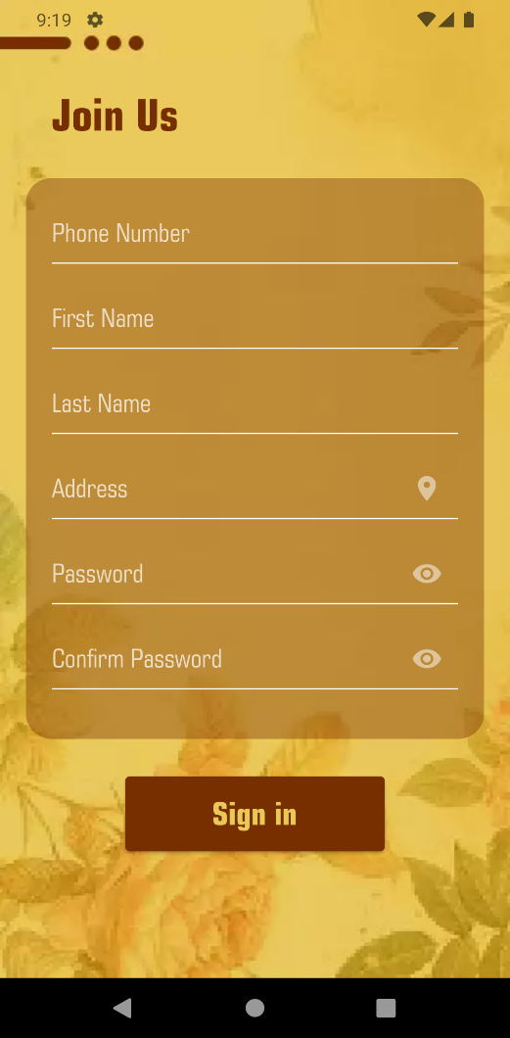
Screenshots
Login
Registration

Slide 11
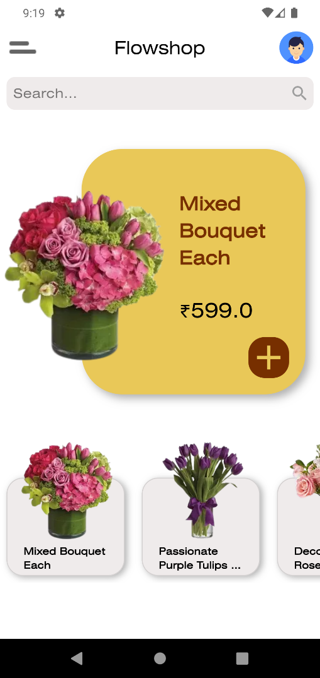
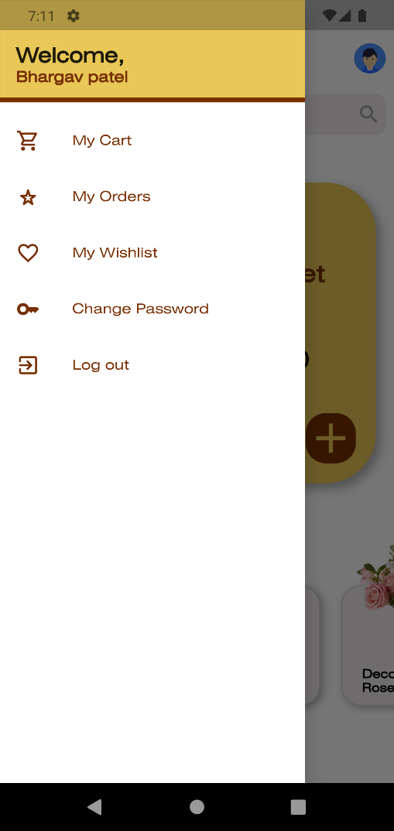
Home
Menu

Slide 12
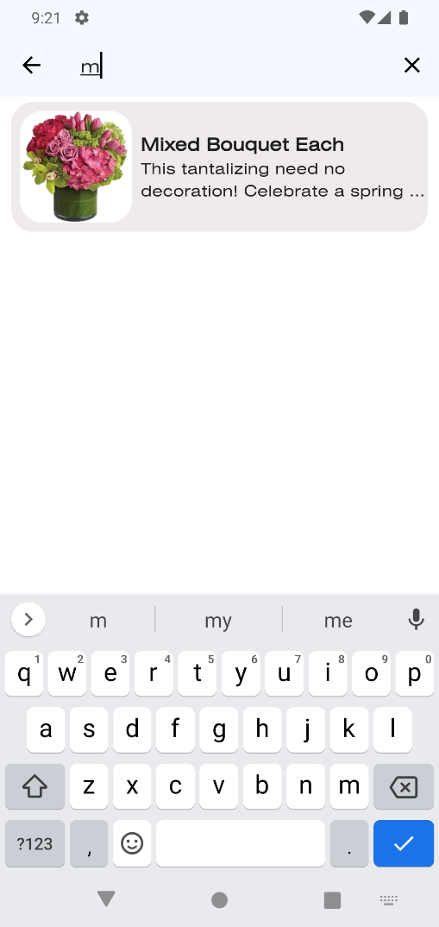
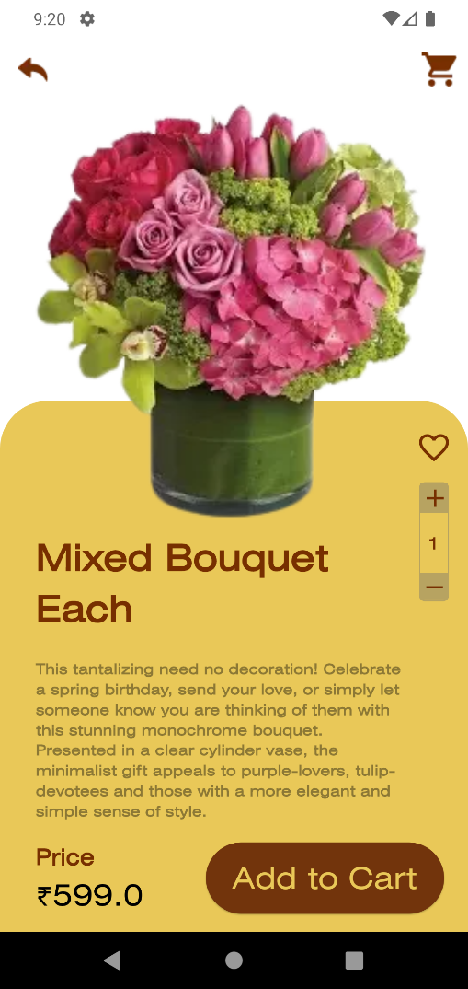
Search
Product View

Slide 13
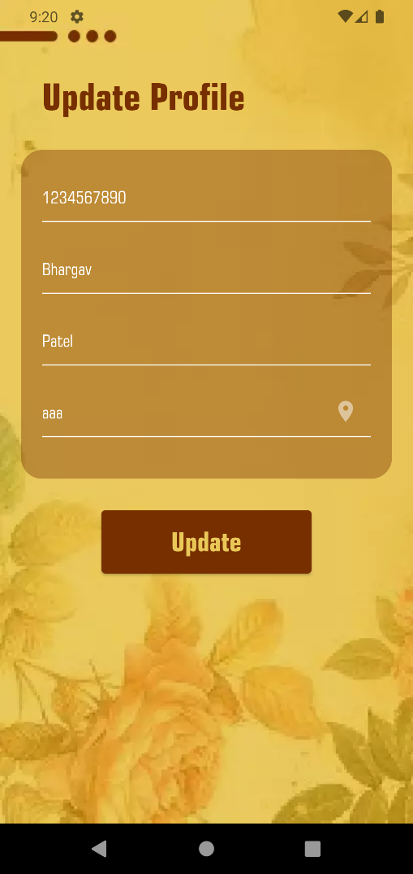
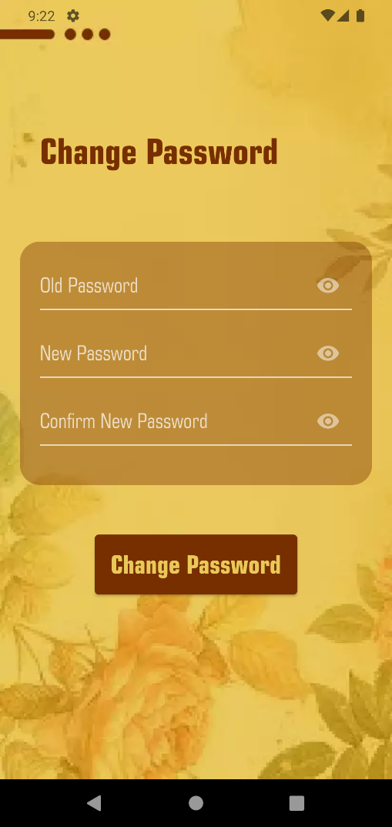
Update Profile
Change Password

Slide 14
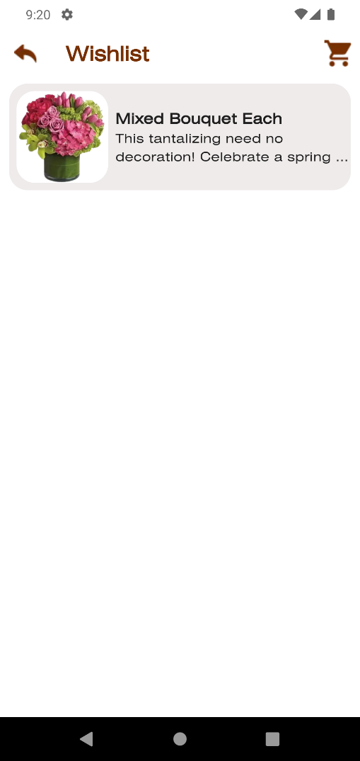
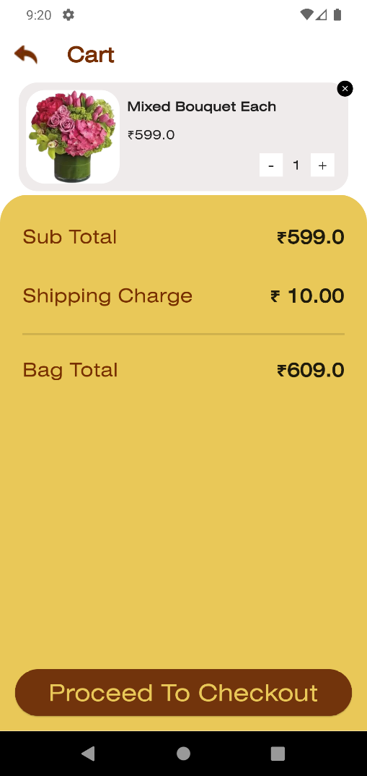
Wishlist
Cart

Slide 15
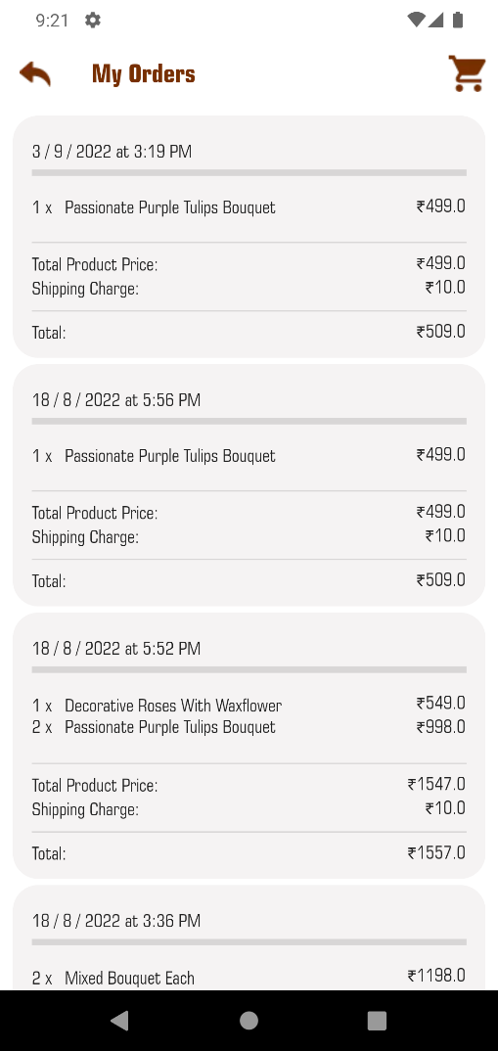
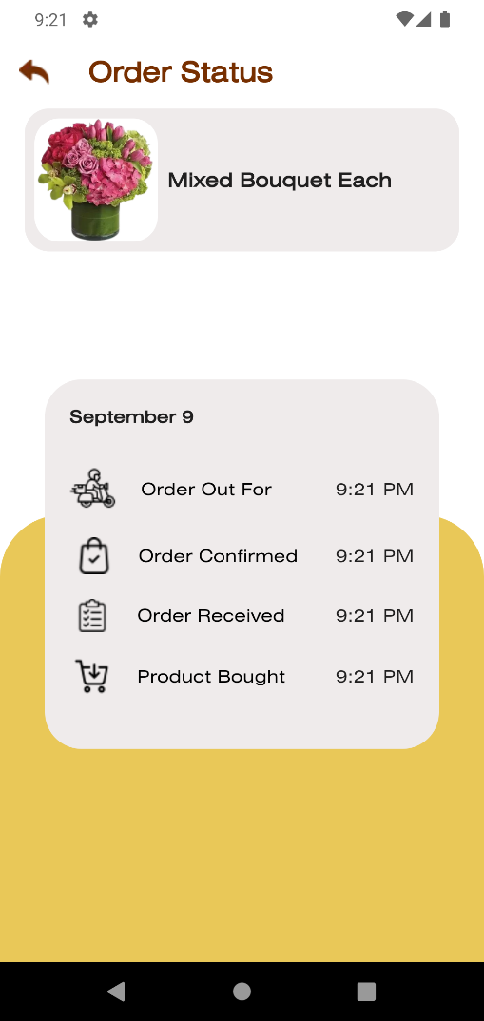
Orders
Order Status

Slide 16
Limitations
This app’s Backed is only depended on SQLite Database
SQLite database is Created in every devices, so Managing the Database for every Device is Very tough.
Products Details , User Details, Order Details are not Sync with any Centralized Online Database. That Means, In Real World, above details are stored in only user’s device Not in Supplier's Server. This is the Main Disadvantage of This Project.

Slide 17
References
Flower Product reference: https://www.teleflora.com/
Coding Reference: 1. https://stackoverflow.com/questions/tagged/flutter
2. https://flutter.dev/
3. https://www.youtube.com/
SQLite Package: https://pub.dev/packages/sqflite

Slide 18


